Slide 1

Trees Chapter 6
Binary Trees, Binary Search Trees, Balanced trees, General trees,
Multi-way trees, Tries, Heaps

Slide 2
What will we learn?
Non-linear data structure
Types of Trees
Operations
Applications

Slide 3
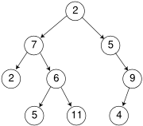
Introduction
A tree consists of a finite set of elements called nodes or vertices and a finite set of edges or directed arcs that connect pairs of nodes.
used to represent any application with a one - to- many relationship.

Slide 4
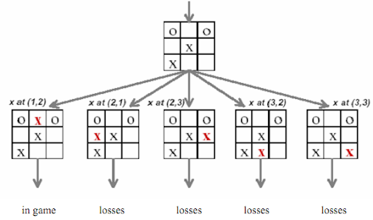
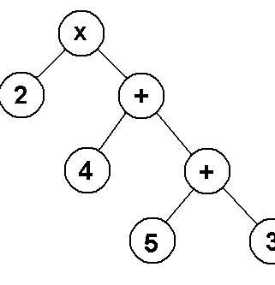
Applications
Trees appear in many situations
File systems in Operating Systems
Hierarchical classification systems
Decision trees
Game trees
Hierarchical organisation of
Organisations, books, XML documents
Representing order or priority
Expression trees 2 * (4 + (5 + 3))

Slide 5

Notation
11 nodes or vertices
Node A = root
Nodes D, I, J, F, K, H = leaves
Node B is a parent node of it's children nodes D, E, F.
The degree is the number of children:
degree of node B ?
Sibling nodes: share same parent:
siblings of node E?
Level/height

Slide 6
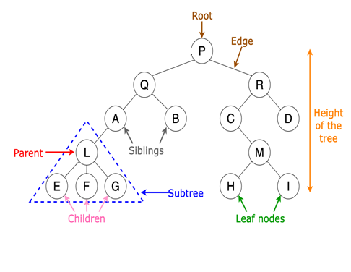
ADT Tree -Operations
parent (v) returns parent of v
children(v) : set of children of v
Child(v) : one child of v
Sibling(v) : siblings of v
isLeaf(v) : true if v is a leaf (an external node)
isInternal(v) : true if v is a non-leaf node
isRoot(v) : true if v is the root

Slide 7
ADT Tree -Operations
Operations on entire tree :
size() returns number of nodes
root() returns root node
height() returns the height

Slide 8

Binary Trees

Slide 9
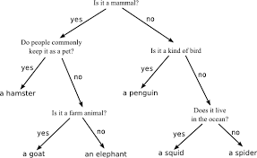
Binary Trees
Trees in which each node has at most 2 children
The children can be subtrees themselves, identified as being the left subtree or the right subtree.
Application:
organise data in linked structure so that can be searched more efficiently, than if it were stored in linked list;
especially useful in modeling processes in which some experiment or test with 2 possible outcomes is performed repeatedly.

Slide 10
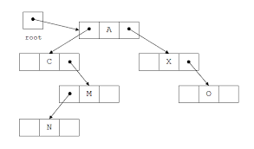
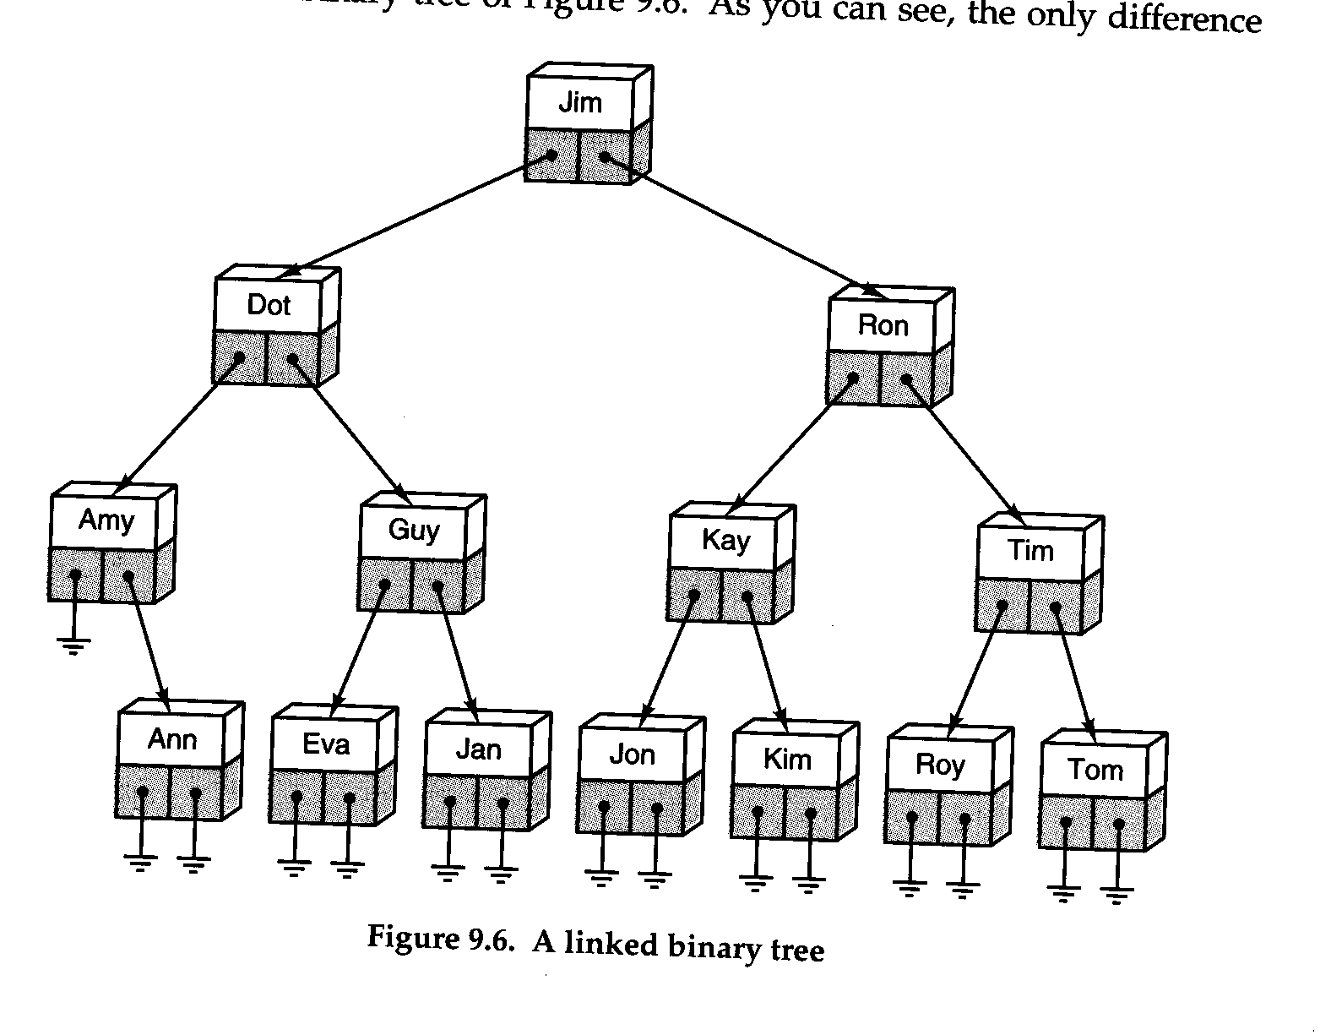
Binary Trees

Slide 11
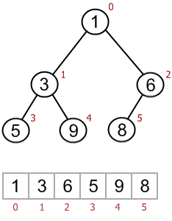
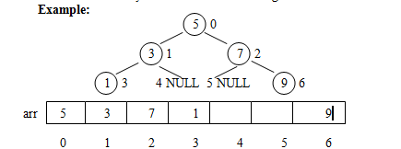
Binary Trees represented as Arrays
A complete binary tree :
Incomplete binary tree :
Implicit representation of edges: Numbering of nodes →index positions
We will discuss this later under Heaps!

Slide 12
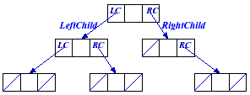
Linked Representation
root
Typedef struct treenode
{
int data;
struct treenode *lchild;
struct treenode *rchild;
} Treenode ;
Treenode *root;
For binary trees: 2 pointers per node, LChild and RChild
If required, a “backward” pointer to the parent node can be added.

Slide 13
Linked Representation

Slide 14
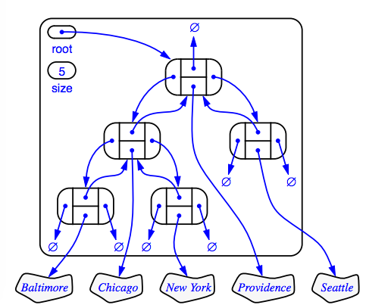
In Full!
https://github.com/erickzhao/comp-250-notes/blob/master/README.md

Slide 15
ADT Binary Tree
In addition to operations earlier:
Specifically for a binary tree:
left(v) returns the left child
right(v) returns the right child
hasLeft(v) test if v has the left child
hasRight(v) test if v has the right child

Slide 16

Traversal of a binary tree.
There are 3 methods
* preorder (depth-first)
* inorder
* postorder
All defined recursively;
traversing involves visiting the root and traversing its left and right subtrees;
only difference among the methods is the order in which these three operations are performed.

Slide 17
Preorder Search
Visit the node
Traverse the left subtree in preorder
Traverse the right subtree in preorder
46 17 2 25 63 97

Slide 18
Inorder Search
Traverse the left subtree in inorder
Visit the node
Traverse the right subtree in inorder
2 17 25 46 63 97

Slide 19
Inorder Search

Slide 20
Postorder Search
Traverse the left subtree in postorder
Traverse the right subtree in postorder
Visit the node
2 25 17 97 63 46

Slide 21
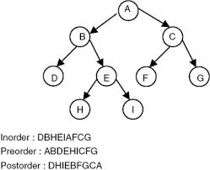
Exercise
Traverse in
postorder, preorder, inorder.
Reveal Answer

Slide 22
Tree traversals using “flags”
The order in which the nodes are visited during a tree traversal can be easily determined by imagining there is a “flag” attached to each node, as follows:
preorder
inorder
postorder
To traverse the tree, collect the flags:
A
A
A
B
C
B
C
B
C
D
E
F
G
D
E
F
G
D
E
F
G
A B D E C F G
D B E A F C G
D E B F G C A
Ref: https://www.cis.upenn.edu/~matuszek/cit594-2005/Lectures/09-binary-trees.ppt

Slide 23
Exercise
Assume each node holds a single character.
1. Show a single tree,
whose preorder traversal yields the order
T E S T I N G
and whose inorder traversal yields the order
S E I T N T G
2. Show a single tree,
whose preorder traversal yields the order MYDIPLOMA
and whose inorder traversal yields the order IDPYLOMMA

Slide 24
Inorder Implementation
Recursive procedure for implementing traversals.
Inorder (Treenode *root){
If (root != Null)
{
Inorder(root->lchild)
{ process root->data }
Inorder (root->rchild)
}
}

Slide 25
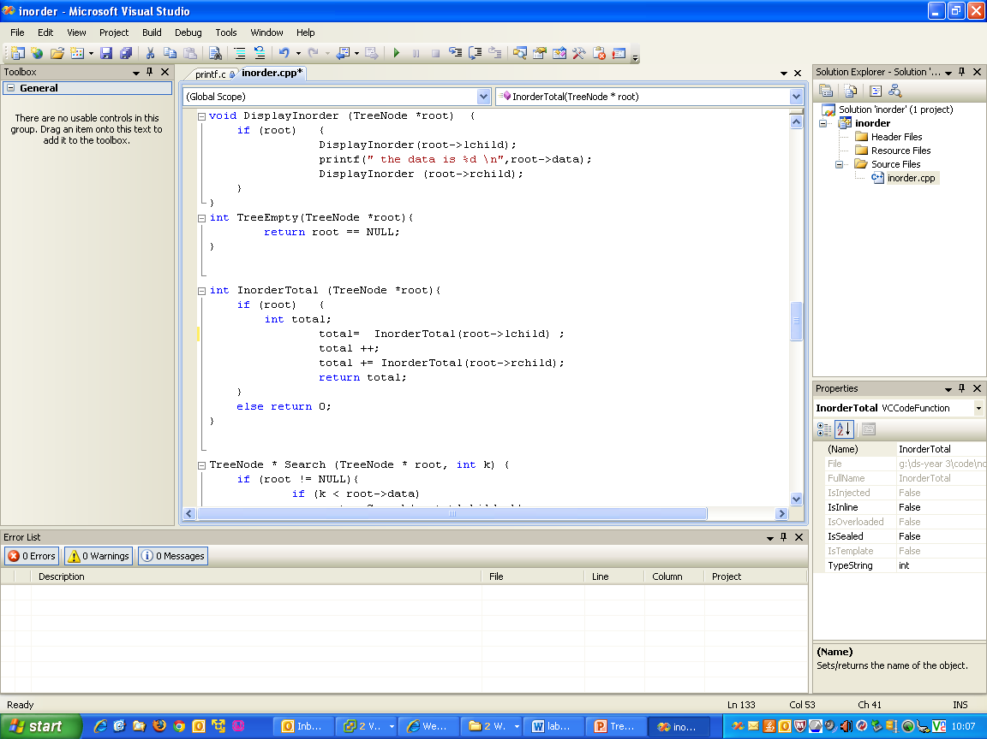
Count

Slide 26
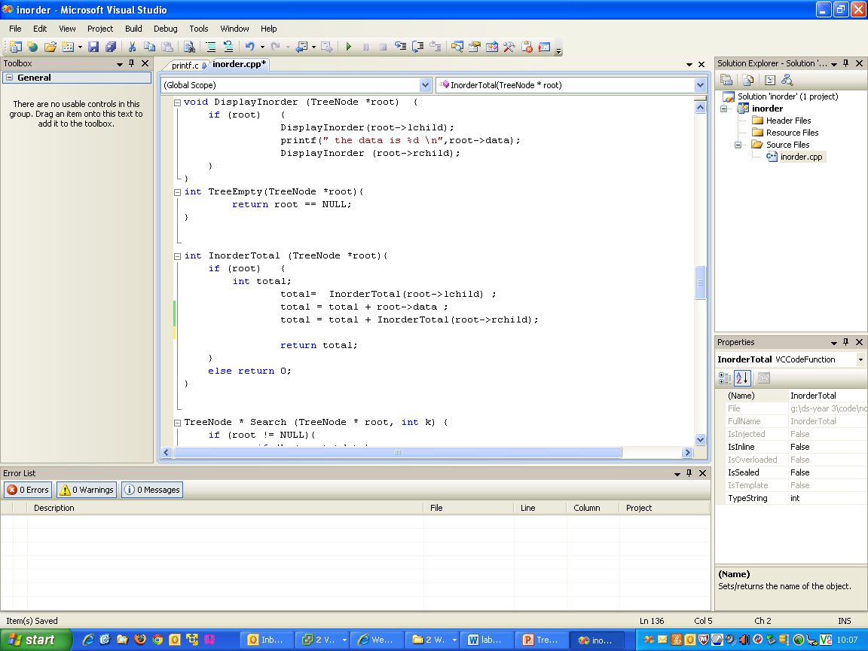
Accumulate

Slide 27
Recursion on Trees
3
8
6
1
2
5
4
3
2
7
9
1

Slide 28
Recursion on Trees
A binary tree is:
- the empty tree (root == NULL)
- a node with a right and a left subtrees.
tree because
3
8
6
1
2
5
4
3
2
7
9
1

Slide 29
Recursion on Trees
A binary tree is:
- the empty tree (root == NULL)
- a node with a right and a left subtrees.
node
3
tree
tree
8
6
1
2
5
4
3
2
7
9
1

Slide 30
Recursion on Trees
A binary tree is:
- the empty tree (root == NULL)
- a node with a right and a left subtrees.
3
tree because
8
6
1
2
5
4
3
2
7
9
1

Slide 31
Recursion on Trees
A binary tree is:
- the empty tree (root == NULL)
- a node with a right and a left subtrees.
3
node
8
6
tree
tree
1
2
5
4
3
2
7
9
1

Slide 32
Recursion on Trees
A binary tree is:
- the empty tree (root == NULL)
- a node with a right and a left subtrees.
3
tree because
8
6
1
2
5
4
3
2
7
9
1

Slide 33
Recursion on Trees
A binary tree is:
- the empty tree (root == NULL)
- a node with a right and a left subtrees.
3
8
6
node
1
2
tree
5
4
tree
3
2
7
9
1

Slide 34
Recursion on Trees
A binary tree is:
- the empty tree (root == NULL)
- a node with a right and a left subtrees.
3
8
6
1
2
5
4
3
2
7
9
tree because
empty
1

